Slide 1
Static Testing
SE401: Software Quality Assurance and Testing

Slide 2
Outline
Static techniques and the test process
Review process
Static analysis by tools

Slide 3

Static Techniques
Know the difference between static and dynamic
Static testing
Dynamic testing
Examination of code without executing it
Can be applied to other work products
Requires source code to be executed

Slide 4
Static Testing
Static Testing
Automatic
Manual

Slide 5
Static Testing
Static Testing
Static Analysis
Review
Informal Review
Walkthrough
Technical Review
Inspection
Coding standards
Code metrics
Code structure

Slide 6
Static Techniques
Static and dynamic testing have the same objective: identifying defects.
They are complementary.
Compared to dynamic testing,
static techniques find causes of failures (defects) rather than the failures themselves.

Slide 7
Static Techniques and the Test Process
Static testing -manual and automated examination of software artefacts without execution of the software under test.
Reviews -a way of testing software products (including code) and can be performed well before dynamic test execution.
Static analysis tools analyze program code

Slide 8
Software Artefacts (Static Testing)
Any type of specifications: business requirements, functional requirements, security requirements
Epics, user stories and acceptance criteria
Design diagrams and models
Code
Test strategy, test plan, test conditions, test cases
User guides, help text, wizards
Web pages
Contracts

Slide 9
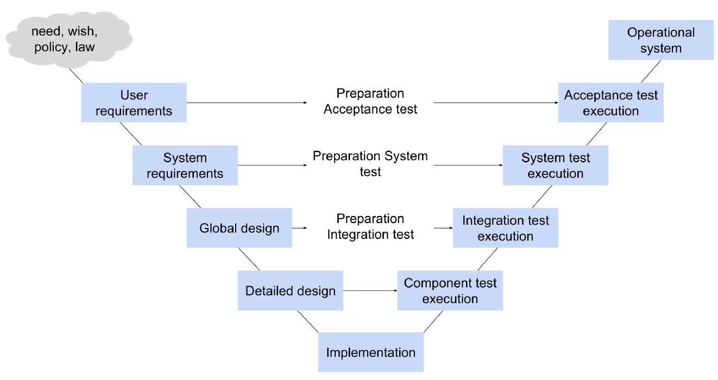
The V-model

Slide 10
Static Analysis by Tools
Objectives of static analysis
Find defects in
software source code
software models
Note! Static analysis finds defects rather than failures
Static analysis is performed without actually executing the software being examined by the tool.
Static analysis tools analyze program code, as well as generated output such as HTML and XML.

Slide 11
Static Analysis by Tools
Typical defects discovered by static analysis tools include:
referencing a variable with an undefined value
inconsistent interface between modules and components
variables that are never used
unreachable(dead) code
programming standards violations
security vulnerabilities
syntax violations of code and software models

Slide 12
Static Analysis by Tools
Developers
Use static analysis before and during:
Component testing
Integration testing
Designers
Use static analysis during software modeling

Slide 13
Static Analysis by Tools
Why is static analysis valuable
Early detection of defects prior to test execution.
Early warning about suspicious aspects of the code or design, by the calculation of metrics, such as a high complexity measure.
Identification of defects not easily found by dynamic testing.
Detecting dependencies and inconsistencies in software models, such as links.
Improved maintainability of code and design.
Prevention of defects, if lessons are learned in development.

Slide 14


Static Analysis by Tools
Coding standards
Recommended that existing standards should be adopted in order to save a lot of effort
Set of programming rules , i .e. always check boundaries on an array when using it
Naming conversions , e.g. class name should start with a Capital letter
Access conversions , e. public/private
Layout specifications, e.g. indents
Checking tools supports code standards

Slide 15


Static Analysis by Tools
Code metrics
Comments frequency
Depth of nesting
Cyclomatic complexity /complexity metrics
Dependency Finder

Slide 16
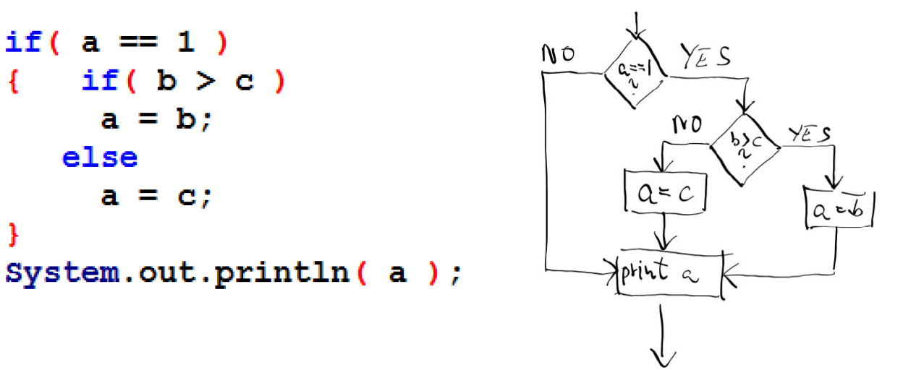
Static Analysis by Tools
Complexity can be measured in different ways, e.g. based on the number of decisions in the program (the number of binary decisions)

Slide 17

Static Analysis by Tools
Code structure
Control flow structure
The sequence in which the instructions are executed
Data flow structure
follows the trail of a data item as it is accessed and modified by the code
Data structure
The organization of the data itself, independent of the program (Array, list, stack, queue, tree, graph, …)
Dependometer
Macker

Slide 18
Static Analysis by Tools
Practical side
Static analysis tools may produce a large number of warning messages , which need to be well managed to allow the most effective use of the tool.

Slide 19
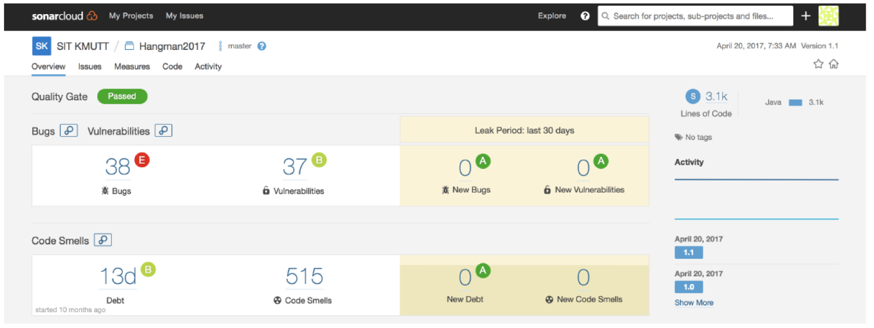
Examples of Testing tools

Slide 20
Reviews
Reviews
is a way of testing software products (including code) and can be performed well before dynamic test execution
Reason to make reviews
Defects detected during reviews early in the life cycle are cheaper to remove than those detected while running tests.
Reviews can find omissions, for example, in requirements, which are unlikely to be found in dynamic testing.
Tools (manual + tool support)
The main manual activity is to examine a work product and make comments about it.

Slide 21
The review process
Object of reviews
Any software work product can be reviewed, e.g.
requirements specifications
design specifications
code
test plans, test specifications, test cases, test scripts
user guides
web pages

Slide 22
The review process
Benefits
early defect detection and correction
development productivity improvements
reduced development timescales
reduced testing cost and time
lifetime cost reductions
fewer defects
improved communication

Slide 23
The review process
Typical defects
deviations from standards
requirement defects
design defects
insufficient maintainability
incorrect interface specifications
inconsistencies, ambiguities, contradictions, omissions, inaccuracies, and redundancies in requirements
These defects are easier to find in reviews than in dynamic testing

Slide 24
The Review Process
Activities of a formal review
Roles and responsibilities
Types of reviews
Review techniques
Success factors for reviews

Slide 25
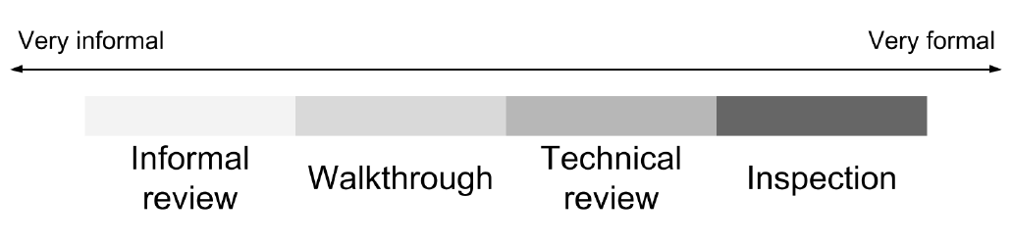
The review process
Different types of reviews vary from:
very informal(e.g. no written instructions for reviewers) to very formal (i.e. well structured and regulated)

Slide 26
Review Process - Background
The formality of a review process is related to factors like
Risk
Size of the project
the maturity of the development process
any legal or regulatory requirements
the need for an audit trail

Slide 27
Review Process - Background
The way a review is carried out depends on the agreed objective of the review:
find defects and omissions
gain understanding
discussion and decision by consensus

Slide 28
Phases of a formal review
Planning
Initiate review – kick off
Individual review – individual preparation
Issue communication and analysis – review meeting
Fixing and reporting – Rework and follow-up

Slide 29
1. Planning
Select the personnel
Allocate roles
Define the entry and exit criteria for more formal review types (e.g. inspection)
Select which parts of documents to look at

Slide 30
2. Initiate review - kick off
Distributing documents
Explaining the objectives of the review and the review process
Explaining the documents to the participants
Checking and discuss entry/exit criteria

Slide 31
3. Individual review/preparation
Work done by each of the participants on their own before the review meeting , noting potential defects , questions and comments
Each participants proposes the severity of the defects
Severity classes: critical, major or minor

Slide 32
4. Issue communication and analysis
Review meeting
Logging and discussion, with documented results or minutes
The meeting participants may simply note defects, make recommendations for handling the defects, or make decisions about the defects.
Decisions based on the exit criteria
Examining, evaluation and recording

Slide 33
5. Fixing and reporting
Rework and follow-up
fixing defects found, typically done by the author.
Check that defects have been addressed
gather metrics, e.g.
number of defects found
number of defects found per page
time spent checking per page
total review effort
etc.

Slide 34
Roles and responsibilities
One person may take one or more roles!
The author
Management
The review leader
The facilitator or moderator
The reviewers
The scribe (or recorder)

Slide 35
Author
The writer or person with chief responsibility for the documents to be reviewed and the rework to be done.

Slide 36
The management
Decides on the execution of reviews
Assigning resources : staff, budget and time
Determines if the review objectives have been met

Slide 37
The review leader
Taking the overall responsibilities for the review
Deciding who will be involved
Works closely with both the management and the facilitator (moderator).

Slide 38
The facilitator or moderator
leads the review of the document(s)
planning the review
running the meetings
and follow up after the meeting
If necessary, the facilitator or moderator may mediate between the various points of view and is often the person upon whom the success of the review rests

Slide 39
The reviewers
Individuals with specific technical or business background
Identify and describe the findings in the product under review
Note: reviewers should be chosen to represent different perspectives and roles in the review process
Note: reviewers should take part in the review meeting

Slide 40
Scribe (or recorder)
Documents all the issues , problems and open points that were identified during the meeting.

Slide 41
Types of reviews
Informal review
Walkthrough
Technical review
Inspections

Slide 42
1. Informal review
Purpose
Inexpensive way to get some benefit
Form
Pair reviews; e.g. pair programming or a technical lead reviewing designs and code
Note: No formal process
Note: Optionally may be documented

Slide 43
2. Walkthrough
Purposes
learning
gaining understanding
defect finding
feedback
Form
meeting led by author
may vary in practice from quite informal to very formal
stakeholders may participate

Slide 44
3. Technical review
Purposes
discuss
make decisions
evaluate alternatives
find defects
solve technical problems
check conformance to specifications and standards
Form
May vary from very formal to informal peer review without management participation.

Slide 45
3. Technical review
ideally led by trained facilitator or moderator
documented, defined defect-detection process; includes peers and technical experts
pre-meeting preparation
optionally the use of checklists, review report, list of findingsand management

Slide 46
4. Inspection
Purpose
Find defects
Form
Usually peer examination led by trained facilitator or moderator (not the author)
Formal process based on rules and checklists with entry and exit criteria
pre-meeting preparation
defined roles
includes metrics
inspection report, list of findings

Slide 47
Review techniques
Ad hoc reviewing
Checklist-based reviewing
Scenario-based reviewing and dry runs
Role-based reviewing
Perspective-based reviewing

Slide 48
Success factors for reviews
Organizational success factors
Have a clear objective
Pick the right review type and technique
Review material need to be keept up to date
Limit the scope of review
Enough time!
Management support is critical

Slide 49
Success factors for reviews
People related success factors
Pick the right reviewers
Use testers
Each reviewers does their review work well
Limit the scope of the review and pick things that really count
Defects found should be welcomed
Review meeting are well managed

Slide 50
Success factors for reviews
People related success factors , continues
Trust is critical
How you communication is important
Follow the rules, but keep it simple
Train participants
Continuously improve process and tools
Just do it!

Slide 51
Success factors - approach
Defects found are welcome and expressed objectively
Apply suitable review techniques for the type and level of software products.
Use checklists or roles if appropriate to increase effectiveness of defect identification.
Management supports a good review process (e.g. by incorporating adequate time for review activities).

Slide 52
Success factors - training and learning
Training is given in review techniques, especially the more formal techniques, such as inspection.
There is an emphasis on learning and process improvement

